Slide 1
2019 NW Region Annual Construction Training
Tribal Liaison Updates
Nicole Flamang NW Region
Native American Hiring Provision/Projects/ 25 CRF Part 169

Slide 2
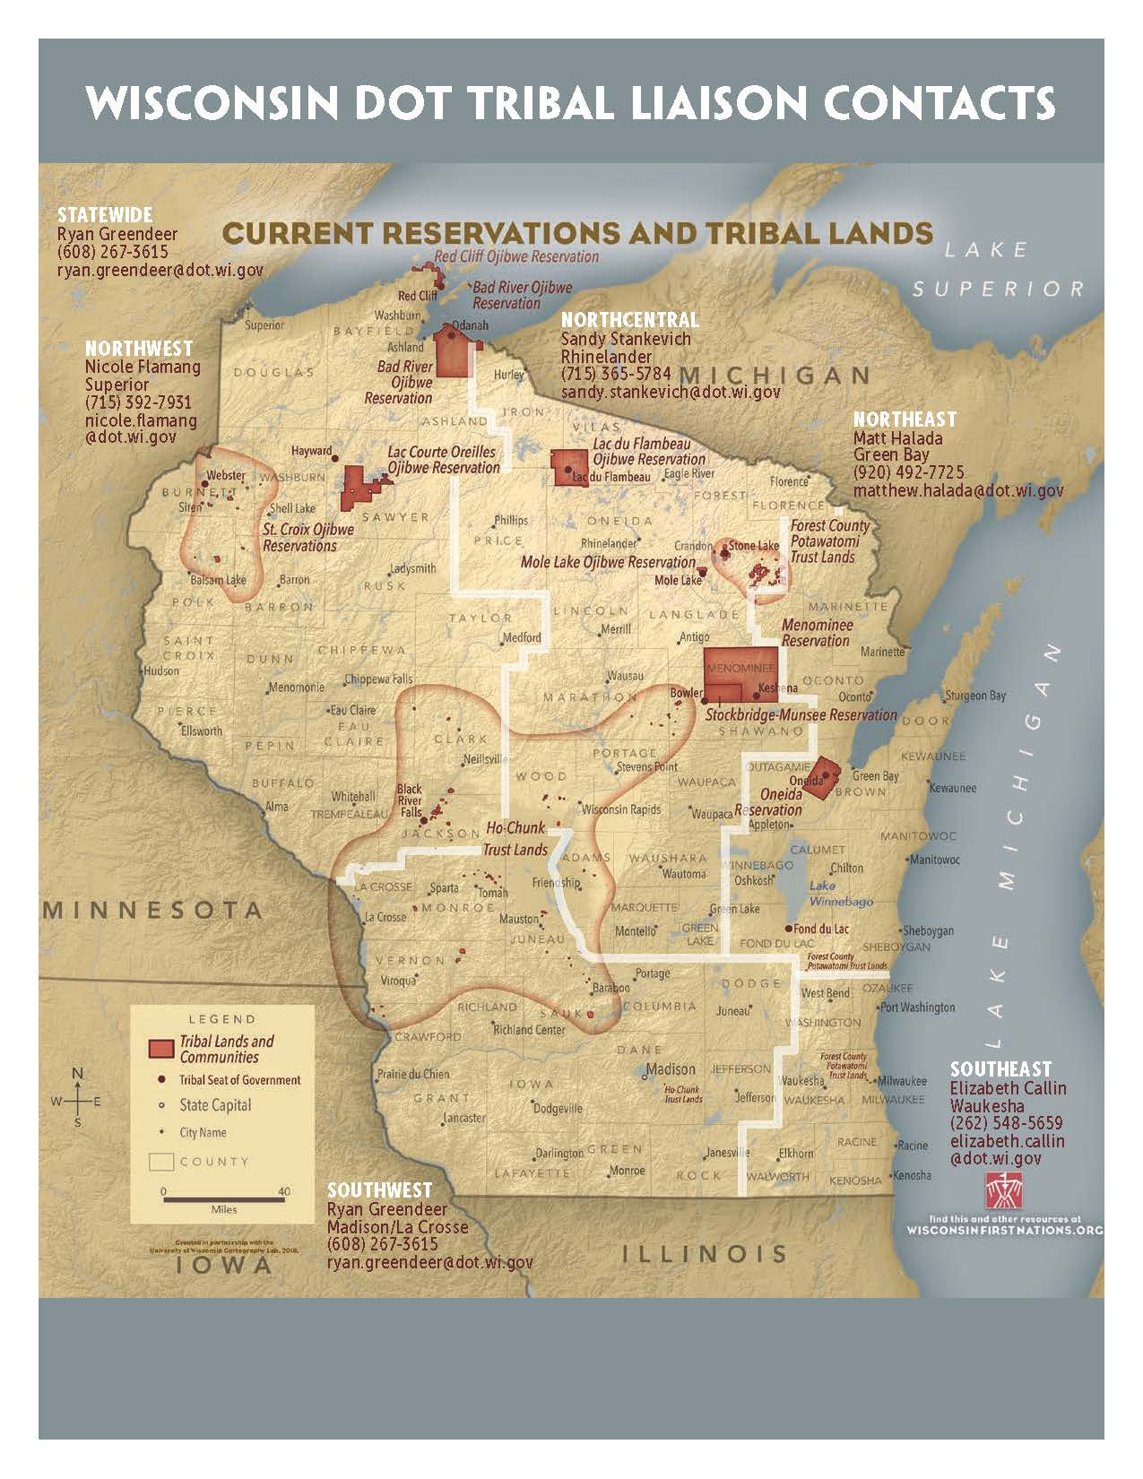
11 federal recognized tribes in Wisconsin
Bad Rivers Band of Lake Superior Chippewa Indians
Lac Courte Oreilles Band of Lake Superior Chippewa Indians
Lac du Flambeau Band of Lake Superior Chippewa Indians
Red Cliff Band of Lake Superior Chippewa Indians
Forest County Potawatomi Community
Ho-Chunk Nation
Menomonie Indian Tribe of Wisconsin
Oneida Tribe of Wisconsin
Stockbridge-Munsee Community Band of Mohican Indians
Sokaogon Chippewa Community
St. Croix Band of Lake Superior Chippewa Indians

Slide 3
WisDOT 2019 Construction Project with NAHP
8560-13-60 STH 77 – St. Croix – Danbury – Minong
7510-02-60 & 62 STH 54 Black River Falls, Oasis Rd to CTH K
Tribal Coordination Meeting
Document all efforts made to communicate job opportunities and the results of hiring activities throughout the life of the contract.
At any time during the life of the contract, provide Tribal communication documentation within five business days of request by the department.

Slide 4
WisDOT 2019 Construction Project with NAHP
8560-13-60 STH 77 – St. Croix – Danbury – Minong
7510-02-60 & 62 STH 54 Black River Falls, Oasis Rd to CTH K
TRANS-
WisDOT’s construction preparation program designed to supply WisDOT contractors with a pool of “pre-qualified”, career-ready workers that represent the communities impacted by federal transportation contracts. TrRANS strives to promote skilled trades career to women and minorities by providing direct access to contractors and paths to apprenticeship in highway.
BIA – 2016 (25 CRF Part 169)
The federal regulation that prohibits “piggybacking” thought an existing right of way.

Slide 5
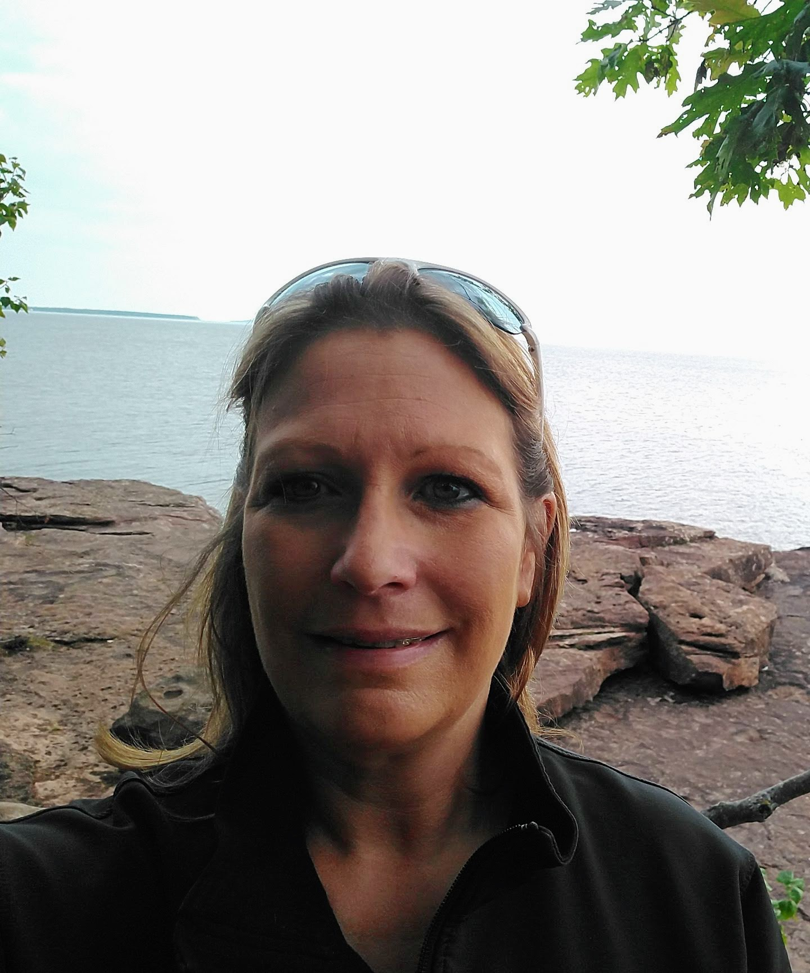
NW Region Tribal Liaison Nicole Flamang (715) 392-7931 nicole.flamang@dot.wi.gov

