Slide 1
Contract Administration/Finals Process
DOT NW Region
2019 Construction Conference
CVTC, Eau Claire, WI
Kris Goodwill, Contract Specialist
3/21/2019

Slide 2
New CMJ Form: Effective 3/5/2019
Notes:
In Pantry under “Statewide Forms”

Slide 3
Finals Process for Let Project Closeout Latest edition of manual: 2/9/2015 http://wisconsindot.gov/rdwy/admin/finals.pdf
BACKGROUND
Establishes six-month (180 days) lead time goal for closing out project.
Required for all LET construction projects.
Start of the Process: “Substantially Complete.”
End of the Process: “Final Estimate”/Completion Certificate

Slide 4
ROLES
PDS Chief: Process Owner
Contract Specialist(CS): Process Lead
Project Engineer(PE): Completes many of the tasks in closing out projects
Enter “Punch List Complete” date in FIT
Consult with PM to determine
“Time Charges Stopped date” (Substantially Complete)
“All Contract Work Complete” date (after punch list is complete)
Enter both in FM
Project Manager(PM): Responsible for Project Closeout success
Contractor: Communicate with PE & ensure timely responses
Notes:
PDS Chief: Responsible for performance for all project closeout timelines on a monthly basis.
CS: Promotes flow of information. Trains project staff in closeout process. Enter late reason codes; receive, track & distribute documents, monitor and update fields in PT, reduce retainage after PM notification, completion certificate, etc.
PE: Complete evaluations, compile records, resolve remaining issues, enter Semi-Final and Final Estimates in FM + inform the PM.

Slide 5
ROLES, Cont.
Labor Compliance Specialist: Monitoring contractor payrolls
Certify payrolls
Verify DBE commitments
Notify PE, PM, CS of payroll issues that require withholding estimates
Materials Engineer/Specialist: Ensure materials adhere to the contract materials documentation & testing requirements.
Contract Records Reviewer: Reviews contract items and quantities for accuracy with contract requirements and ensure all documentation is in finals. Usually, the PM, sometimes a consultant.
Notify PE, PM, CS when review is complete/CS puts date in Project Tracking.
Notes:
PM: review and sign closeout documents, complete or delegate finals review, approve semi-final estimate, request CS to reduce retainer, request CS to send Final Acceptance Ltr, approve Final Estimate, sign completion certificate.
Contractor: Work with Labor Compliance on payroll/wage issues. Resolve quantity issues. Review & return semi-final within 30 calendar days. Complete DQI with PE. Complete subcontractor certification & evaluation of project team.
Labor Compliance: Enter reason codes and remarks in PT when payroll issues delay closeout. Complete final payroll audit, enter payroll clear date into PT and notify closeout team (via e-mail).

Slide 6
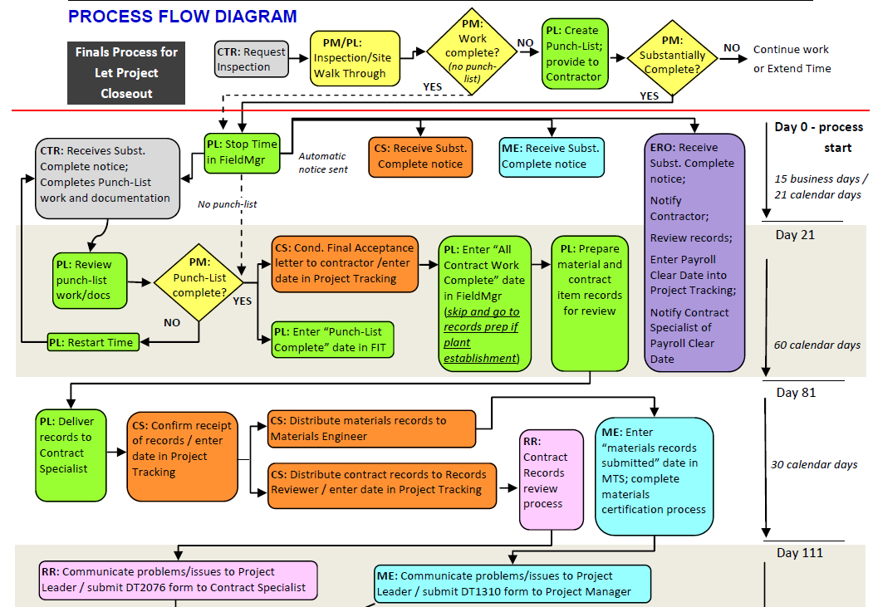
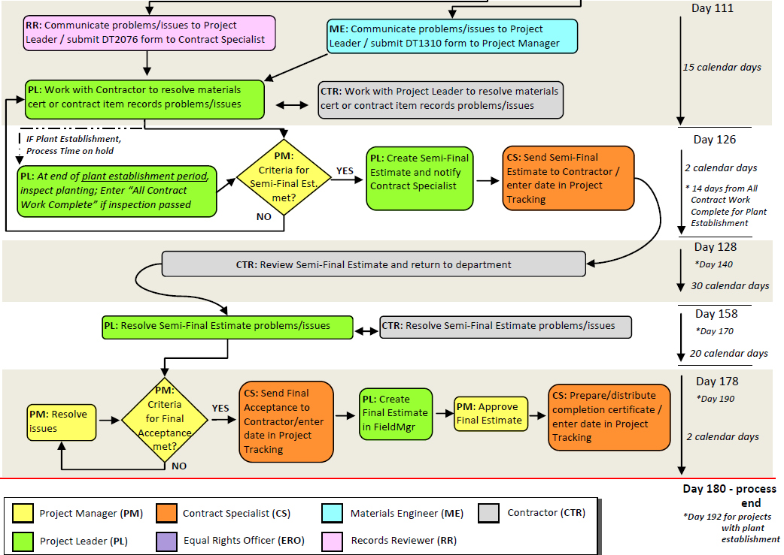
FINALS PROCESS
FLOW DIAGRAM

Slide 7
180 Day Timeline
Dates provided within the Process Flow Diagram are general guidelines. The most important deadline is the 180 closeout date.
1. Inspection/Punch-List: Contractor notifies PE that work is complete. PM & PE conduct an inspection and categorize work as follows:
a. Unacceptable or not complete.
b. Complete except for Punch-List.
c. Complete and no Punch-List is required.
Punch List Definition: List of minor corrective work, job site clean-up and contract required documents not submitted.

Slide 8
1. Inspection/Punch List, Cont.
If work unacceptable:
Tell contractor to continue work.
If no time is left on contract and liquidated damages will not be assessed, prepare a contract mod to extend time (calendar day and completion date contracts).
Or suspend/resume time (working day contracts).
When all work is complete OR no punch list items, PE should enter date of inspection in FIT “Punch-List Complete” date field and merge the FIT data so it shows up in Project Tracking (PT). Inform the CS because this triggers the preparation of the Conditional Final Acceptance letter!

Slide 9
FM Site Events Used to Suspend/Resume time and work.

Slide 10
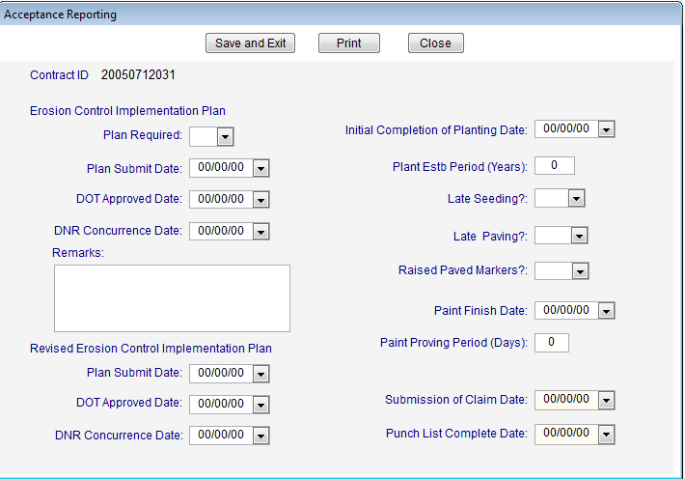

Slide 11
2. Time Charges Stopped/Substantially Complete
Stops contract time charges & “starts the 180 day closeout period”
What needs to be done beforehand?
Site walk through by PE & PM and punch-list composed
All contract items are complete
All lanes of traffic open on a finished surface
All signage & traffic control devices in place and operating
All drainage, erosion control, excavation, embankments complete
All safety related items complete
Notes:
#2. Except punch list items and contract items associated with proving periods.

Slide 12
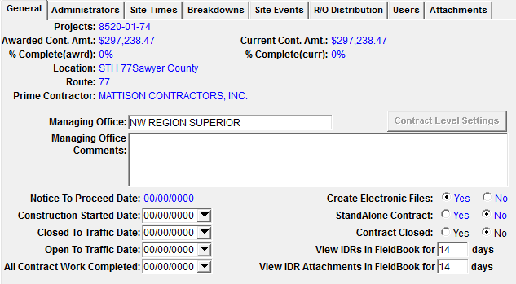
FIELD MANAGER
Under the General Tab “All contract work completed” and under Site Times Tab “Time Charges Stop Date”.

Slide 13
2. Time Charges Stopped/Substantially Complete, Cont.
When criteria met:
PE provides punch-list to contractor.
Enters “Time Charges Stopped/Substantially Complete” date in FM and sends to FIT (The date is automatically transferred to PT in both “Substantially Complete” and “Time Charges Stopped” fields).
PT system automatically sends an e-mail with substantially complete date and close out date to PM, PE, CS, Labor Compliance, Materials, and Contractor.
Notes:
If a proving period, see the handout of Standard Spec 646.3.3.4.

Slide 14
3. Conditional Final Acceptance
Per PE or PM direction, CS sends the letter and enters the date into PT.
Relieves contractor of maintenance responsibility for completed work (except proving periods & plant est. periods).
PE enters date into FM and the Conditional Final Acceptance letter is issued.
4. All Contract Work Complete Date
Notes:
3. Contract work must be substantially complete and punch-list has been completed before PE (in consultation with PM) issues conditional final acceptance to contractor. Conditional Final Acceptance is not in Field Manager. The PE/PM informs the CS and CS sends the letter stating the project has Cond. Final Acceptance. PE enters “Punch-List” complete date in FIT –Shown on Slide 8.
4. If a proving period or plant est. period, the all contract work complete date is entered after the proving period is complete and work is inspected. In the meantime, should continue to next step in finals process.

Slide 15
5. Preparation of Material/Contract Records for Review
PE has 60 days from the issue date of Conditional Final Acceptance to prepare material and contract records for review
Final records shall be in standard State Records Center boxes
Upon receipt of records, the PM informs the CS so he/she can enter the contract records submission date in PT. ****
Notes:
The NW Region is discussing and I know has included in special provisions that delivery of records be done 81 days from substantially complete date.
There are handouts of DT2075 – Final Project Record Checklist as well as the NW Finals checklist. In our Region, we use both forms!

Slide 16
6. Certification of Materials (30 days from receipt of records)
Upon receipt from PM.
Materials Engineer enters “Materials Records Submitted” date in MTS
If acceptable: Materials Engineer and PM signs DT1310
ME enters “Reviewed” date and “Certification” date in MTS (This gets transferred over to PT)
Materials Engineer informs project team via e-mail
7. Review Process/ 8. Materials Resolution
PM confirms that all records are reviewed using DT2075 (Review Form).
CS enters the “Contract Records Reviewed” date in PT so need to inform CS when review is complete!
If issues identified (materials or contract records), the PE and contractor have 15 calendar days from completion of review to resolve.
Notes:
7. CS documents that records are received, provided to the reviewer, fills in “reviewed by” in PT. When complete, reviewer submits the completed DT2075 to the CS.
Although I know many times, issues are resolved during the review.

Slide 17
9. Payroll Clear Date Process
Labor compliance verifies that all certified payroll & labor compliance issues resolved and enters the Payroll Clear date into PT
A Payroll Clear Date must be issued before the Final Estimate is sent to the Contractor
10. Contract Work Complete for Projects with Plant Est. Periods
PE enters the “All Contract Work Complete” date into FM
Relieves the contractor of maintenance responsibility for contract work with plant est. periods
Not filling in that date until Plant Est. period is complete.

Slide 18
11. Semi-Final Estimate
Serves to notify contractor that the engineer has measured & reported all contract quantities & materials requirements.
Unresolved contract records (part of PM Review), payroll issues or materials certification issues are to be resolved before semi-final estimate is issued. See CMM 2-36.1.3.
PM directs the PE to create the semi-final (tentative final) in FM
DO NOT SEND THE SEMI-FINAL UNTIL DIRECTED BY THE PM!
All of this is done in conjunction with the CS.
If reducing retainage, should be done BEFORE the PE creates the semi-final and definitely before the PM approves it!****
Notes:
A PM can direct the semi-final be sent if review of records is complete, certification of materials is complete, and any issues related to the Payroll Clear date have been communicated to the PM & contractor.
The PM reviews & approves the semi-final and notifies the CS. The CS sends a hard copy of it to the contractor and enters “semi-final to contractor” date in PT.

Slide 19
12. Contractor Review of Semi-Final Estimate
Contractor has 30 days to review and return to DOT
Upon receipt of signed semi-final voucher:
CS confirms with the PE and the PM that project is ready for final acceptance
Possible for the 30 day deadline to be extended upon mutual agreement
13. Semi-Final Estimate Issue Resolution
The PE/PM and the contractor should resolve any semi-final issues within 20 calendar days of the contractor returning the semi-final
When resolved, PE/PM informs CS and the CS enters the date in PT
Notes:
15 days into the 30 days, an e-mail sent to CS, PM & PE from Roadway Stds.
If CS has not received a response in 30 days, he/she follows up with PM, PE or Contractor.
If no issues, CS puts in the same date the semi-final was returned. Many times issues are already being addressed during the 30 day timeline.

Slide 20
14. Final Acceptance
Issued when:
Semi-final issues resolved
Materials certified
Records review complete
Payroll clear date issued
Contractor has provided signed the “Subcontractor Final Payment and Retainage Certification”
CS sends out the Final Acceptance letter before the final estimate.
Notes:
“Subcontractor Final Payment and Retainage Certificate” – Contractor stating all subs paid and no retainage is being withheld.

Slide 21
15. Final Estimate Approved
Confirms final completed contract work
Confirms contract item quantities
Releases all retainage
In conjunction with the CS, PM directs PE to create final estimate in FM & the PM approves it.
PM/CS signs Completion Certificate; CS distributes
CS goes into People Soft to confirm Contractor was paid final estimate, then prepares Completion Certificate.
Notes:
The CS prepares and distributes the Completion Certificate to the bonding company, project files, FHWA (when applicable) and enters the date in PT.

Slide 22
Additional Roles of the CS
Send Team Evaluation of the Contractor (DT2510) to contractor. If not complete, sending to PE for completion. Enter completion date in PT.
Send Sub’s Final Payment & Retainage Cert form to Contractor. Enter completion date in PT.
Send DT2509 Contractor’s Evaluation of the Project Team to Contractor. Enter completion date in PT.
Remove as-built plan from finals materials and verify accuracy of stamp fields, list the contract mods & include a total value. Verify Final Contract Cost in PT. See Handout.
Send out all Contractor Evaluations from finals box (includes prime and all subs on the project).
Sends appropriate correspondence to County Highway Commissioners, FHWA, DOT Maintenance, etc.
Sends final records to storage or Records Manager; enters “Records to Storage” date in PT.
Notes:
As-built Plan comments: Do not separate out revised structure pages. Better if document not “read only” protected. Con Mods: want the number of con mods, the amount of each and the total of all con mods.

Slide 23
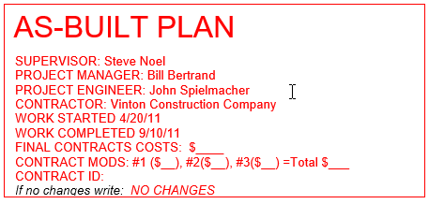
NW Region As-Built Instructions
More closely follows language in the CMM 1-65.14.1.
NW Region now using Flash Drives to submit As-builts.
Notes:
Do not submit password protected or “read only” electronic files. Work Completed date is the Substantially Complete/Time Charges Stopped date, not the All Contract Work Completed date.

Slide 24
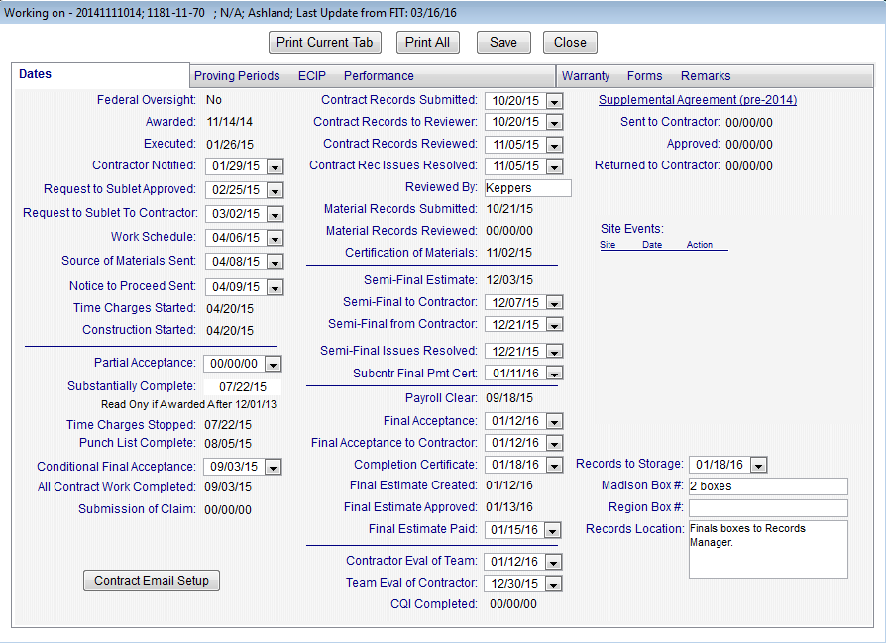
Notes:
From “Status” in PT. Date fields without drop down boxes are transferred from another source – usually FM or FIT.

Slide 25
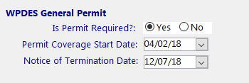
WPDES Permits
New Requirement in 2018 for each project to obtain a separate permit.
Information put in Project Tracking.
Cannot Final a project until WPDES permit is terminated via a letter from the WDNR.

Slide 26
Reason Codes for Late Finals
CDLY Contractor Delay
CLMS Claims
CNQI Construction Quality Issues/Repairs to be Addressed
DNRP DNR WPDES Permit Coverage Not Terminated
MTLS Nonconforming Materials
OTHR Other
PLFC Project Leader Delay/Finals Corrections Needed
PLST Punch List Items to be Completed
QTYD Quantity Disputes
SFST Staff Shortage
WCLW Wage Claim/Investigation Labor Compliance

Slide 27
Miscellaneous/Resources
Pantry is now web-based. The link was distributed early this year to the Construction distribution list. The new WisDOT AASHTOWare Project (AWP) Knowledge Base website (AWPKB) is located here: https://awpkb.dot.wi.gov/Content/Default.htm
2018 Field Software User’s Guide for Construction Staff is in Pantry 2019. NW Region Pantry contains the “Finals Process Flow” document and the NW Region Construction Contract Administration Manual.
Be careful with timing of estimates. If PM denies an estimate, the ACM administrators receive an e-mail. Retainage must be reduced by CS before estimate is generated and approved. The Final Acceptance letter is sent out before the Final estimate is created and approved.

Slide 28
Upcoming: AWP Construction
Replaces CAS, Field Manager, FieldBook, FieldNet, Field Information Tracking (FIT) and Project Tracking.
Web based with external access for consultants and contractors.
Connects to Mobile Inspector for Daily Work Reports (IDRs).
Test and Pilot - Spring/Summer 2019
Training - Fall/Winter 2019
Proposed Production date – Spring 2020
Notes:
Fit, Merge and Send will be obsolete! Yay!

