Slide 1
Project Communications: Construction Season
Diana Maas, NWR Communications Manager
March 21, 2019

Slide 2
Overview
Project Information
Weekly Construction Updates
Project Milestones
Photos

Slide 3
Project Start Press Release
Complete a project kick-off press release
Template: E:\PDS\Resource&Reference\Project Start News Release Template.docx
RCM needs to send 10 days/ 2 weeks prior to construction

Slide 4
Weekly Construction Updates
Due by COB Wednesday
Email to RCM: diana.maas@dot.wi.gov
Updated form – please use for consistency
E:\PDS\Resource&Reference\Weekly Construction Update blank form 2019 - with Materials.docx
Eau Claire public drive > PDS
Weekly updates are shared online and with region media and legislators
http://projects.511wi.gov/weeklyupdates-nw/

Slide 5
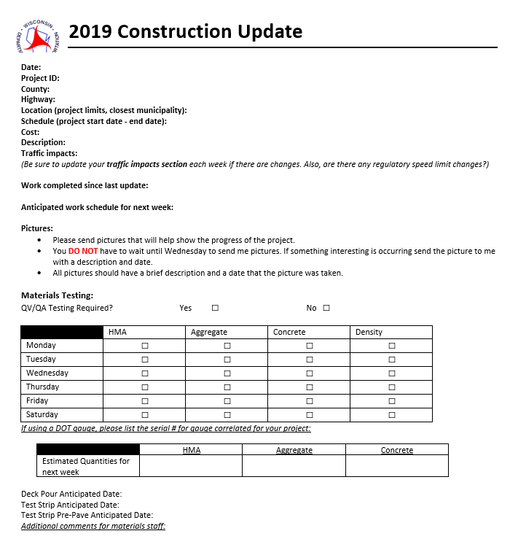

Slide 6
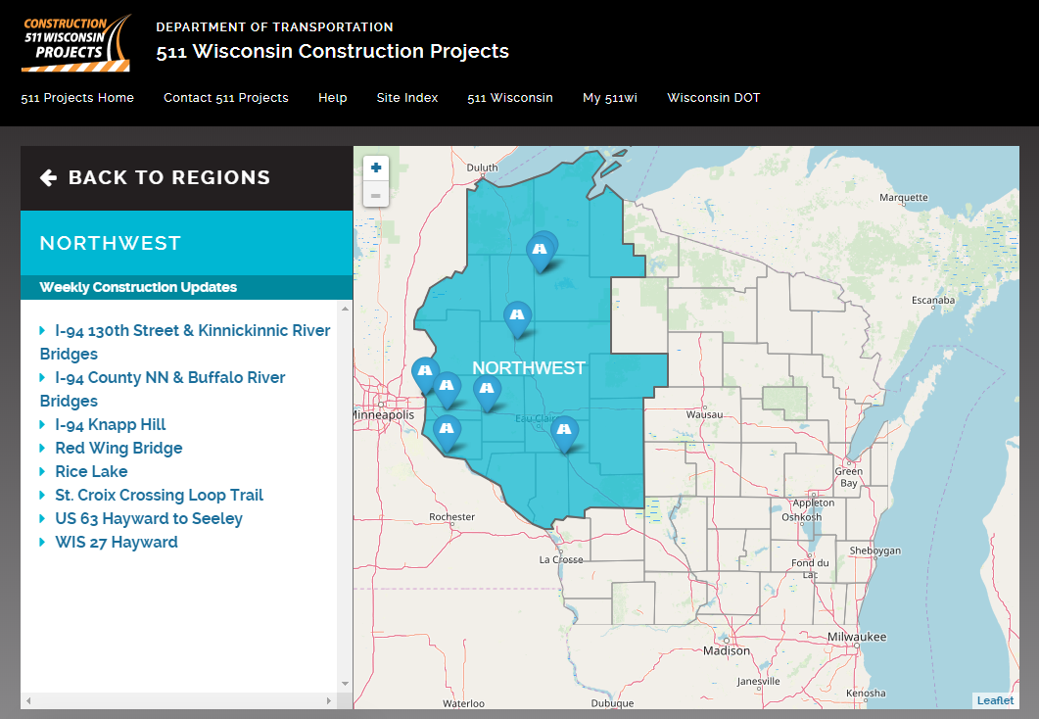
projects.511wi.gov/region/northwest/

Slide 7
Project Milestones
Be sure to keep RCM updated on milestones
RCM site visits and/or positive project press
Social Media updates with photos/ video

Slide 8
Photos
Take pictures – a lot of pictures!
Before – look for places that will show a contrast when the improvements are complete
During – photos with orange cones, crews in vests, big equipment and project milestones are important
After – completed project with live traffic if possible
As soon as you have them, email or text them to RCM Diana Maas

Slide 9
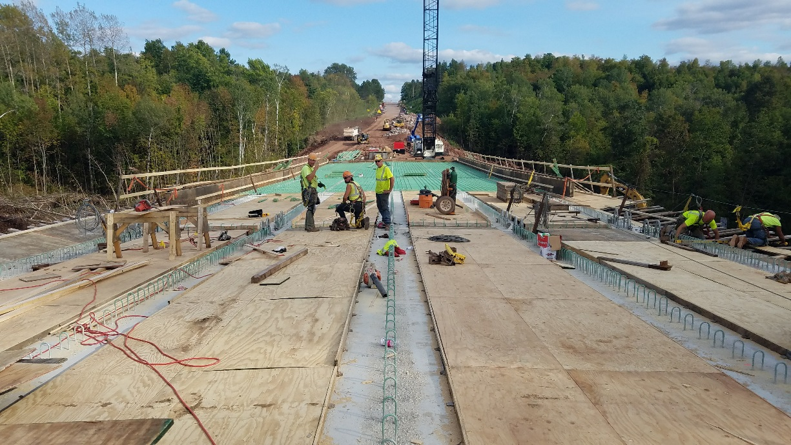
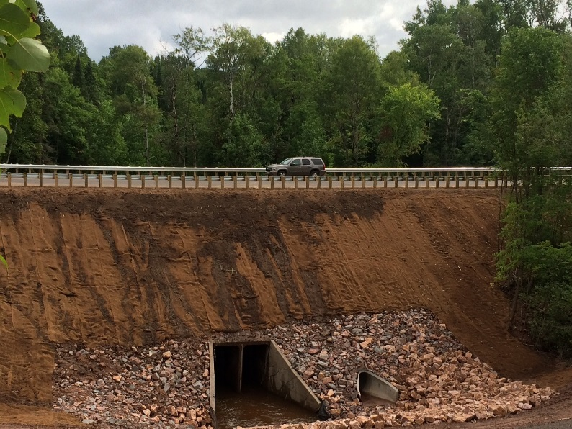
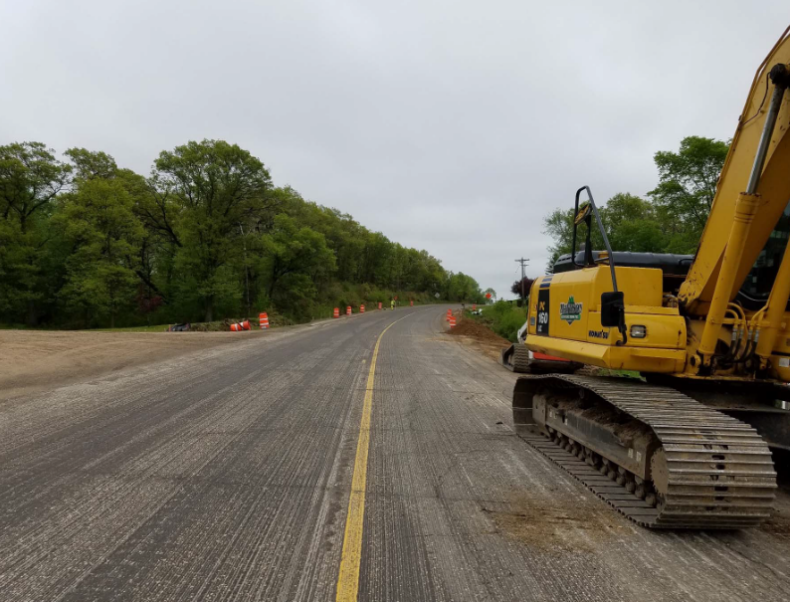
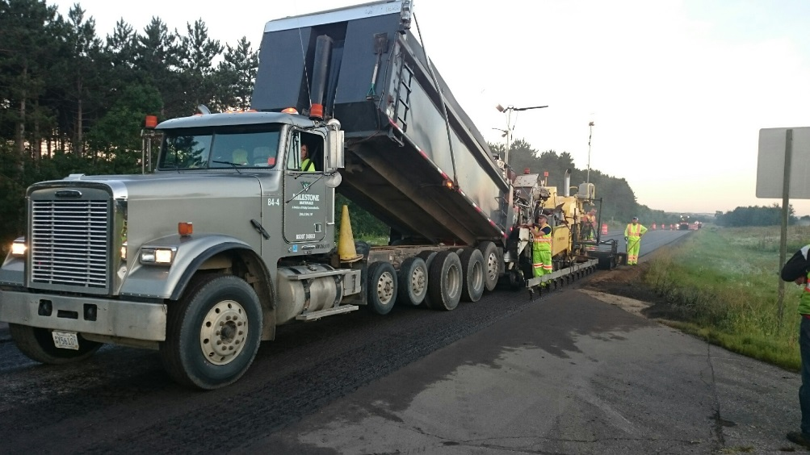
Examples of Quality Photos

Slide 10
Contact Information
Diana Maas
diana.maas@dot.wi.gov
(715) 635-4968 office
(715) 828-9471 cell

