Slide 1
Bureau of Project Development (BPD) Update
Matt Dapp
NW Region Construction Oversight Engineer
2019 NW Region Construction Training
Casper Conference Center, Eau Claire, WI
(Remote Locations – Spooner & Superior)
March 21, 2019

Slide 2
Introduction
Experience
WisDOT for 11+ years
SW Region – Madison Office
Previous 5 years as a project manager in PDS
Managed both design and construction projects
Dane, Columbia, Iowa & Lafayette Counties
Served 1 year as SW Region Utility Engineer
First 5 years spent as inspector/project leader on construction projects in Dane County

Slide 3
Agenda
BPD Updates
When to Contact Construction Oversight Engineer
Contractor Schedules
Contract Modification Justification (CMJ)
Contract Change Order (CCO)
Project Disputes / Claims
Other Topics

Slide 4
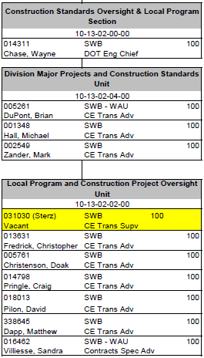
BPD Construction Standards Oversight Unit Updates
Matt Dapp – NW Region
Doak Christenson – SW Region
Craig Pringle– NE Region
Dave Pilon – NC Region
Chris Fredrick – SE Region
Brian DuPont – SE Freeways
Michael Hall – Standard Specifications
Mark Zander – CMM Updates
Sandra Villiesse – Local Program

Slide 5
When to Contact Construction Oversight Engineer?
All proposed cost reduction incentives (CRI)
Include on CRI Tracking Form
Decisions that should be made at a statewide level
Material shortages
Cataclysmic phenomena of nature (extreme weather)
Potential claim issues
Basis of entitlement
Questions with interpretation of contract specifications
Large-scale change orders/contract time extensions
Time extensions that may go over winter

Slide 6
When to Contact Construction Oversight Engineer?
Issues with the standard specifications
Any submission of claim or notice of claim
Statewide consistency questions
Assessing liquidated damages
A resource to bounce ideas off

Slide 7
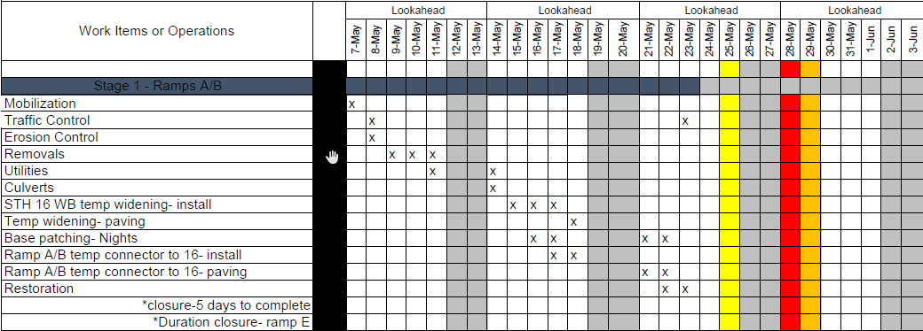
Contractor Schedules
Follow SS 108.4 Progress Schedules
Verify baseline schedules
Request narrative & other items
Account for long lead procurement items
Require monthly updates
Review and comment
Avoid “implied consent”

Slide 8
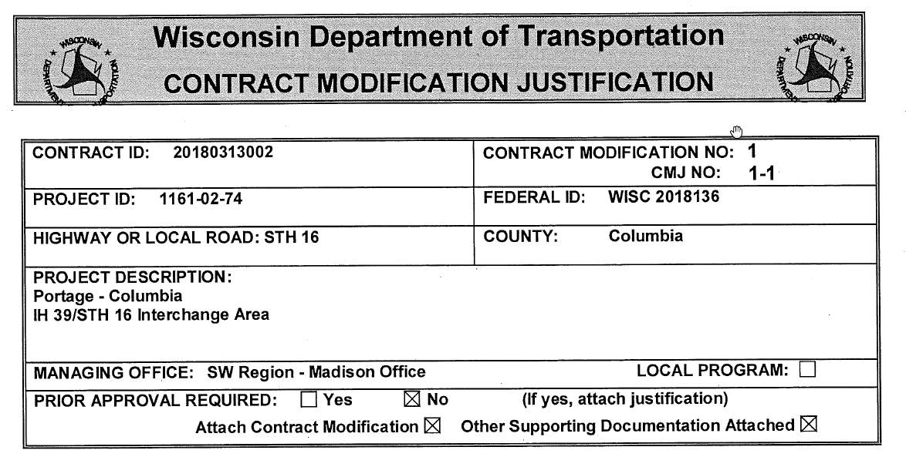
Contract Modification Justification (CMJ)
Documents must address:
Scope (entitlement)
Quality
Time
Cost
Written as a standalone document
Include attachments for all references
Should not have to refer to the plans & specials to understand
Should include an independent engineer’s estimate
Do more than just confirm the price submitted from the contractor
In theory, the CMJ should be written before you receive any pricing from the contractor

Slide 9
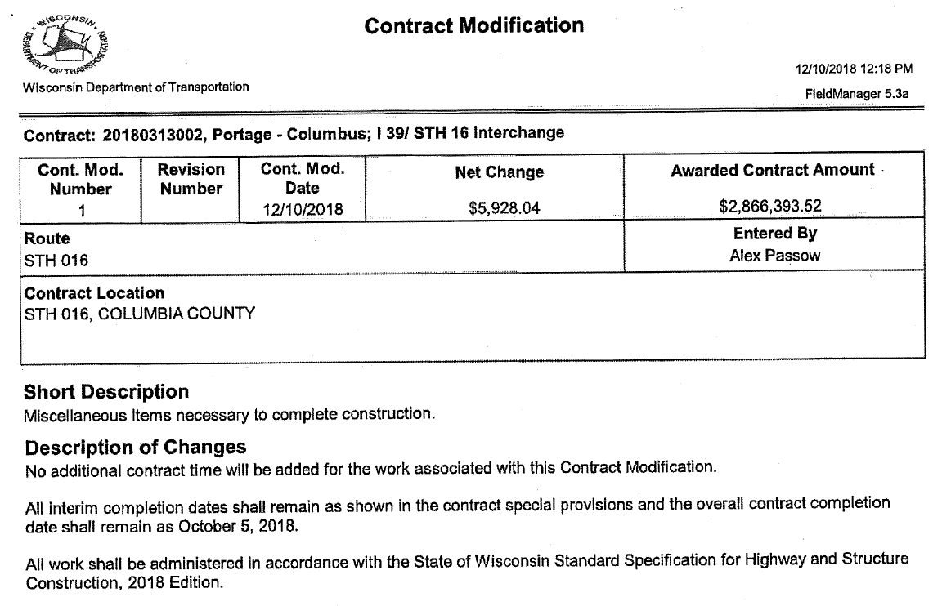
Contract Change Order (CCO) (Contract Modification)
Cover all related issues in one CCO
May require multiple CMJ’s
Be consistent within region
Commonly see:
No additional contract time is provided by this contract modification
Replace with example in CMM 2-42 (Attachment 1):
Additional contract time will not be provided to complete the work required and covered in the contract modification

Slide 10
Project Disputes / Claims
Claim is an unresolved change or dispute resulting in a demand for additional cost, time, or both based on:
Entitlement (why?)
Impact (what or how?)
Cost (how much?)
Ensure proper notification is given to allow department to mitigate
Read the contract as a whole to determine if there has been a change to the contract requirements (entitlement)
Differing site conditions
Suspensions of work ordered by the engineer
Significant changes in the character of work
Separate original contract from claim cost
Ask for contractor documents such as Job Cost Report that shows actual costs

Slide 11
Other Topics
Detailed documentation
Utilize laptops, iPads, etc.
Set expectations with contractor early and often
Avoids issue of implied consent
Review Critical Inspection Guide
Recent issues with beam guard posts & sign post embedment
Damage to contractor’s work
Do not pay for damage to contractor’s work unless covered in contract (SS 107.14 Contractor’s Responsibility for Work)
Enforce the contract
Consistency within the regions

Slide 12
Questions?
Contact Information
Email: matthew.dapp@dot.wi.gov
Phone: (608) 266-3589
Cell: (608) 516-6481

